Slide 1

Middle Range Theory Presentation
Theory Name: Maternal Role Theory by Ramona Mercer
Student Name: Emily Laughlin

Slide 2
Introduction of Theory
Created for all mothers, as well as nontraditional mother, to adopt maternal identity (Nursing Theory, 2019)
Can be used during pregnancy through childbirth and beyond (Nursing Theory, 2019; Meighan, 2017)
Helps the mother and infant form bonds with one another (Nursing Theory, 2019)

Slide 3
Theorist(s) Information
Theorist(s) name
Background (Zukauskas, 2024)
Education (Zukauskas, 2024)
St. Margaret’s School of Nursing
University of New Mexico
Emory University
University of Pittsburgh
Professional Work (Zukauskas, 2024)
Ramona Mercer
Born Oct. 4, 1929
Died Aug. 10, 2023
Married forty years
Worked for 10 years in various specialties (i.e., Pediatrics and OB)
Taught at Emory University
Taught at University of California, San Francisco
Wrote several books
Two children and four grandchildren
Notes:
Husband Lewis Mercer
Graduated St. Marg 1950
Graduated New Mex 1962 with Bach
Graduated Emory in 1964 with master’s
Worked 5 years at Emory in ATL GA as a teacher
Met Reva Rubin at Pittsburgh
Worked at California for remainder of career
Some books include Nursing Care for Parents at Risk (1977) and Perspectives on Adolescent Health Care (1979) focuses on teen mothers
1986 First-Time Motherhood: Experiences From Teens to Forties
Graduated Pittsburgh in 1973 with doctorate in maternity nursing

Slide 4
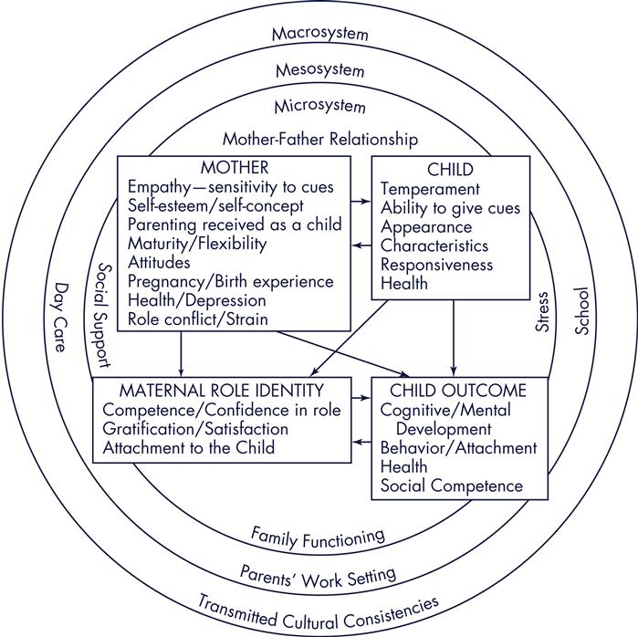
Description of Theory with
Concepts and Diagram
Four stages (Meighan, 2017)
  1. Commitment and Preparation- Pregnancy (Anticipatory stage)
  2. Acquaintance, practice, and physical restoration- First 2 weeks (Formal stage)
  3. Approaching normalization- 2 weeks to 4 months (Informal stage)
  4. Integration of maternal identity- 4 months and on (Personal stage)
Mercer (1985) quote retrieved from: McEwen, M., & Wills, E. M. (2023). Theoretical basis for nursing. Wolters Kluwer.
Notes:
Commitment- maternal role expectations explored; social and psych adjustments to pregnancy; info and advice from other mothers and visualizes herself in the role
Acquaintance- birth of the infant and birth recovery; role-taking stage; competence through practice
Approaching normalization- learns infant cues, develops own style of mothering; settling in
Integration- internalizes role and gains self-esteem; views self as a competent mother

Slide 5
Possible Application of Theory to Nursing Practice, Education, or Research
Post-partum nurses can use this theory to help the mother with the transition (McEwen and Wills, 2023)
Nurses provide education and support to new mothers (Zukauskas, 2024)
Can be useful for nontraditional mothers (Nursing Theory, 2019)
Notes:
Help in transition by offering guidance, promoting socialization and parenting groups
Nontraditional mothers include foster parents, adoptive parents, unexpected motherhood as with the death of a relative

Slide 6
Summary
Four stages
Used with traditional and non-traditional mothers
Many things affect success of maternal role attainment
  Infant cues and temperament
  Mother’s health
  Infant’s health
  Father/significant other support
Maternal role is on an ongoing, fluctuating process
Nurses play a pivotal role in the process

Slide 7
References
McEwen, M., & Wills, E. M. (2023). Theoretical basis for nursing. Wolters Kluwer.
Meighan, M. (2017, January 10). Mercer’s becoming a mother theory in nursing practice. Nurse Key. https://nursekey.com/mercers-becoming-a- mother-theory-in-nursing-practice/
Meighan, M. (2017). Model of maternal role attainment. Nurse Key. Retrieved April 20, 2025, from https://nursekey.com/wp- content/uploads/2017/01/F000179f17-02-9780323091893.jpg.
Ramona Mercer. Nursing Theory. (2019, September 17). https://nursing- theory.org/nursing-theorists/Ramona-Mercer.php
Zukauskas, R. (2024). Ramona T. Mercer. EBSCO Information Services, Inc. | www.ebsco.com. https://www.ebsco.com/research-starters/nursing-and- allied-health/ramona-t-mercer

