Slide 1
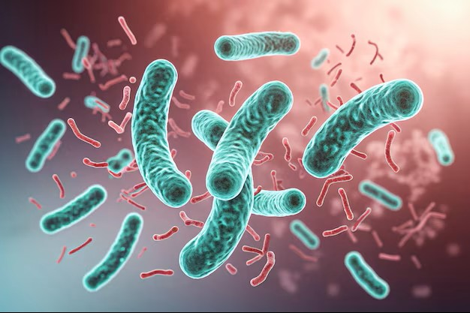
Cholera
Emily Laughlin

Slide 2
Background
Cholera is a bacteria that is spread through contaminated food and water (Centers for Disease Control and Prevention [CDC], 2025)
Signs/Symptoms (CDC, 2025)
Diarrhea/vomiting Leg cramps
Dehydration Restlessness/irritability
Treatment includes oral rehydration and antibiotics for severely ill patients (CDC, 2025)

Slide 3
Introduction into the U.S.
Cholera was heavily present in the United States in the 1800s (CDC, 2025)
Cholera isn’t as common now in the U.S., with less than 20 cases per year, due to modern water treatment systems(CDC, 2025)
It is usually brought in by people traveling abroad from places where cholera is present (CDC, 2025)

Slide 4

Health organizations
&
Eradication
Centers for Disease Control and Prevention (CDC)
Provides expertise to local governments (CDC, 2025)
Trains labs to identify cholera (CDC, 2025)
Educates communities on prevention (CDC, 2025)
World Health Organization (WHO)
Oral cholera vaccine (WHO, 2024)
Rapid diagnostic tests for early detection (WHO, 2024)
Global Taskforce on Cholera Control (GTFCC)
All countries encouraged to form a National Cholera Plan to help decrease cholera deaths by 90% by 2030 (GTFCC, 2025)

Slide 5

Places with high cholera outbreaks have less access to clean water (Chowdhury et al., 2022)
  These countries include Bangladesh, Pakistan, Nepal, and India (Chowdhury et al., 2022)
    They allow open defecation in rural areas, have poor handwashing compliance, and shared latrines among the poor (Chowdhury et al., 2022)

Slide 6

2 million people globally do not have access to clean drinking water (CDC, 2025)
1.4 million deaths attributed to diseases spread through dirty water (CDC, 2025)

Slide 7

Healthcare
Implications
Governments and healthcare facilities should report cholera cases within 24 hours (GTFCC, 2025)
In a cholera outbreak, mortality rates remain less than 1% if immediate response measures are taken (Holtz, 2022) These include:
  Clean water
  Sanitation
  Hygiene education
  Safe food handling
WASH (Water, Sanitation, and Hygiene)
  Adequate education for healthcare workers (Elimian et al., 2023)
Surveillance and recognition (Elimian et al., 2023)

Slide 8
References
Centers for Disease Control and Prevention. (2025, May 29). CDC at work: Cholera. Centers for Disease Control and Prevention.
Centers for Disease Control and Prevention. (2025, May 29). Cholera. Centers for Disease Control and Prevention.
Centers for Disease Control and Prevention. (2025, May 29). Cholera in the United States. Centers for Disease Control and Prevention.
Centers for Disease Control and Prevention. (2025, July 29). Global hygiene. Centers for Disease Control and Prevention.
Centers for Disease Control and Prevention. (2025, May 29). Signs and symptoms of cholera. Centers for Disease Control and Prevention.
Centers for Disease Control and Prevention. (2025, May 29). Treating cholera. Centers for Disease Control and Prevention.
Cholera images - free download on Freepik. (n.d.). https://www.freepik.com/free-photos-vectors/cholera
Chowdhury, F., Ross, A. G., Islam, M. T., McMillan, N. A., & Qadri, F. (2022, September 21). Diagnosis, management, and future control of cholera. Clinical microbiology reviews.
Elimian, K., King, C., Dewa, O., Pembi, E., Gandi, B., Yennan, S., Myles, P., Pritchard, C., Forsberg, B. C., & Alfvén, T. (2023, February 1). Healthcare workers knowledge of cholera multi-stranded interventions and its determining factors in north-east nigeria: Planning and policy implications. Human resources for health.
Global Taskforce on Cholera Control. (2025, April). Guidance document 2024 public health surveillance for cholera. Global Taskforce on Cholera Control.
Holtz, C. (2022). Global Health Care: Issues and policies. Jones & Bartlett Learning.
Roadmap 2030. GTFCC. (2025).
World Health Organization. (2024, December 5). Cholera. World Health Organization.

