Slide 1
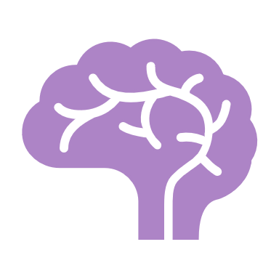
Serotonin
Emily Laughlin

Slide 2
Functions (Cleveland Clinic, 2025)
Digestion
Mood
Sleep
Wound healing
Bone health
Blood Clotting
Libido
Notes:
90% of serotonin is found in the GI tract; 10% in the brain; speeds digestion to rid body of toxins; reduces appetite
Increases mood; happy, calm, emotionally stable; low levels associated with depression
Plays a role in quality of sleep and how long you sleep; also needed to make melatonin
Released by platelets to help heal wounds
Can play a role in bone density; high levels can cause bones to become weak, causing fractures
Along with dopamine increases sexual desire

Slide 3
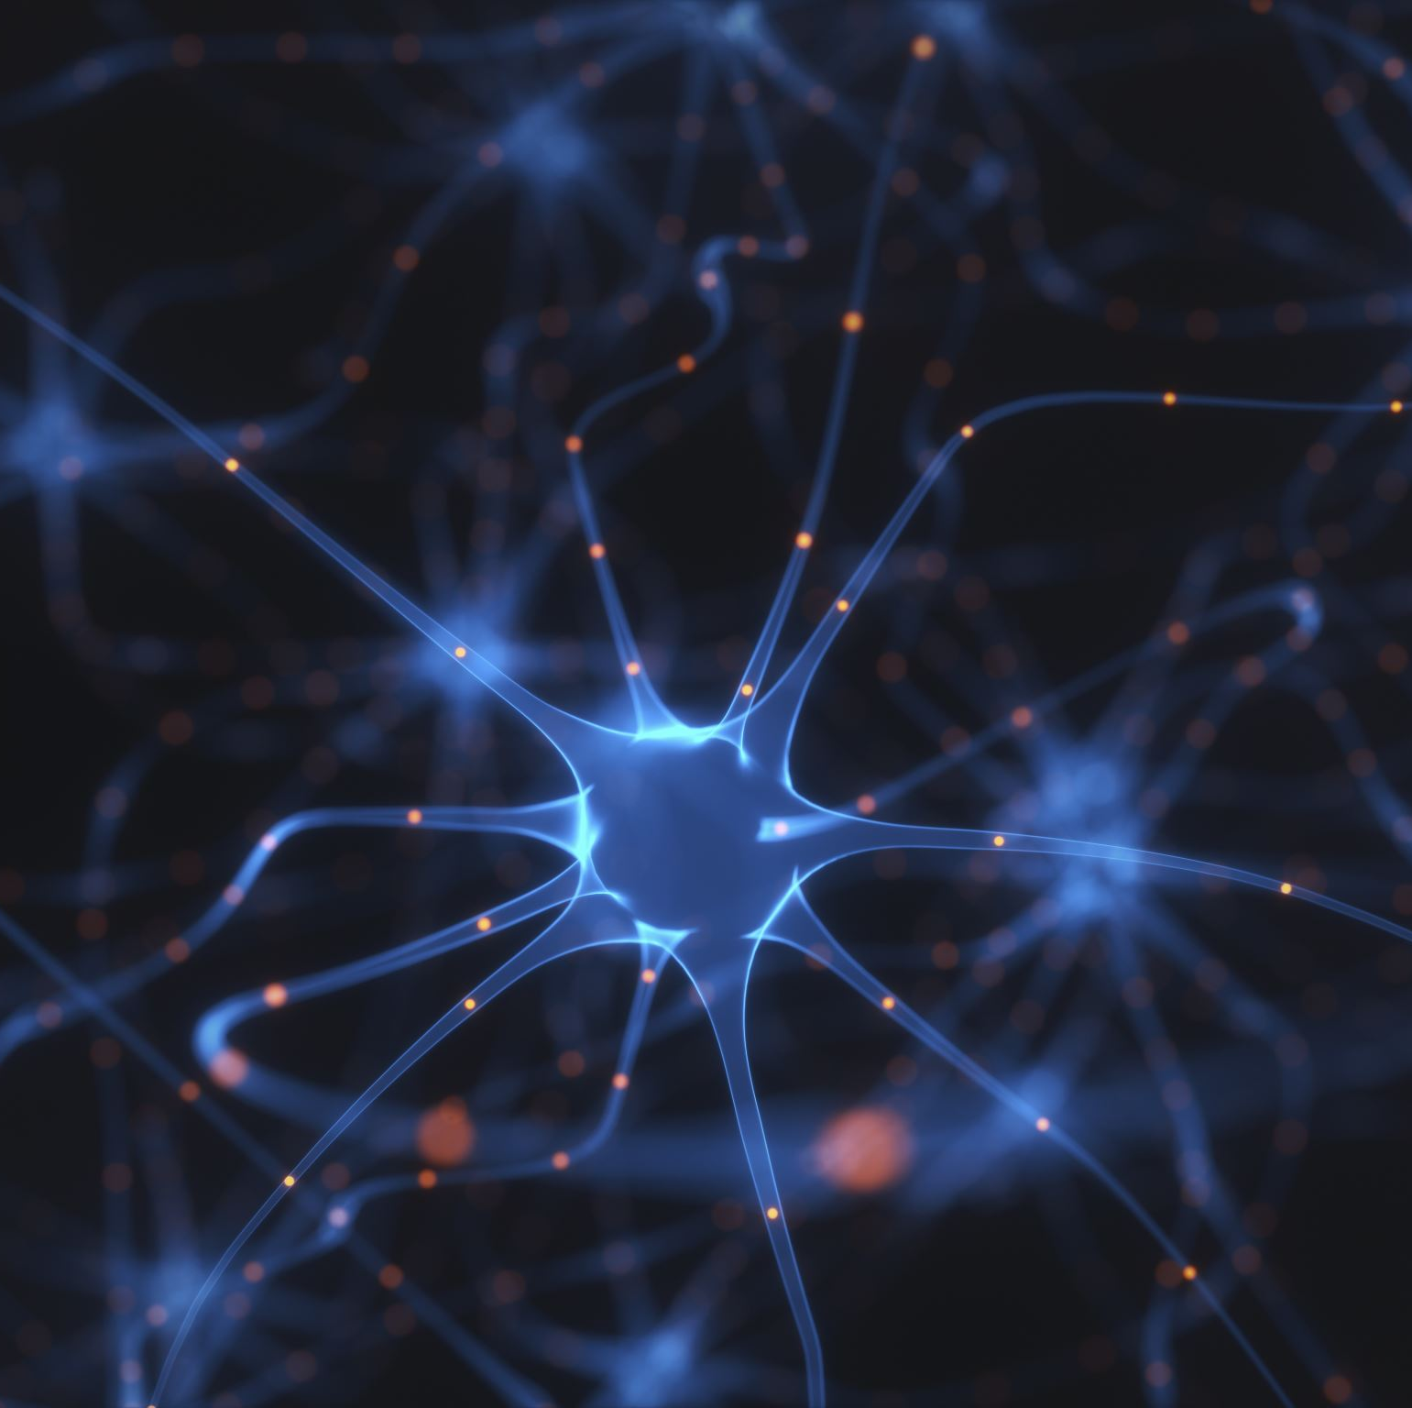
Pathway (Guy-Evans, 2023)
Serotonin originates in the brain stem in the Raphe nuclei
Raphe nuclei synthesizes serotonergic fibers and projects them to the nucleus accumbens
It is projected all throughout the brain
It is released to the synaptic cleft during neurotransmission
Notes:
The nucleus accumbens is part of the basal forebrain known as the circuit area for rewards

Slide 4
Is serotonin excitatory or inhibitory?
Serotonin can be both depending on the receptors it binds to and the location of the brain. (Guy-Evans, 2023)

Slide 5
References
Cleveland Clinic. (2025, May 7). Serotonin: What is it, Function & Levels. Cleveland Clinic. https://my.clevelandclinic.org/health/articles/22572-serotonin
Guy-Evans, O. (2023, September 18). What does serotonin do? neurotransmitter function. Simply Psychology. https://www.simplypsychology.org/what-is-serotonin.html

