Slide 1

Culturally and Linguistically Appropriate Services (CLAS)
1
Emily Laughlin

Slide 2

Objectives
2
1
Look at CLAS Standard #1
2
Look at Ballad Health’s policy on discrimination
3
See how Ballad Health compares with the CLAS standards

Slide 3
CLAS Standard #1
Provide effective, equitable, understandable, and respectful quality care and services that are responsive to diverse cultural health beliefs and practices, preferred languages, health literacy, and other communication needs

Slide 4
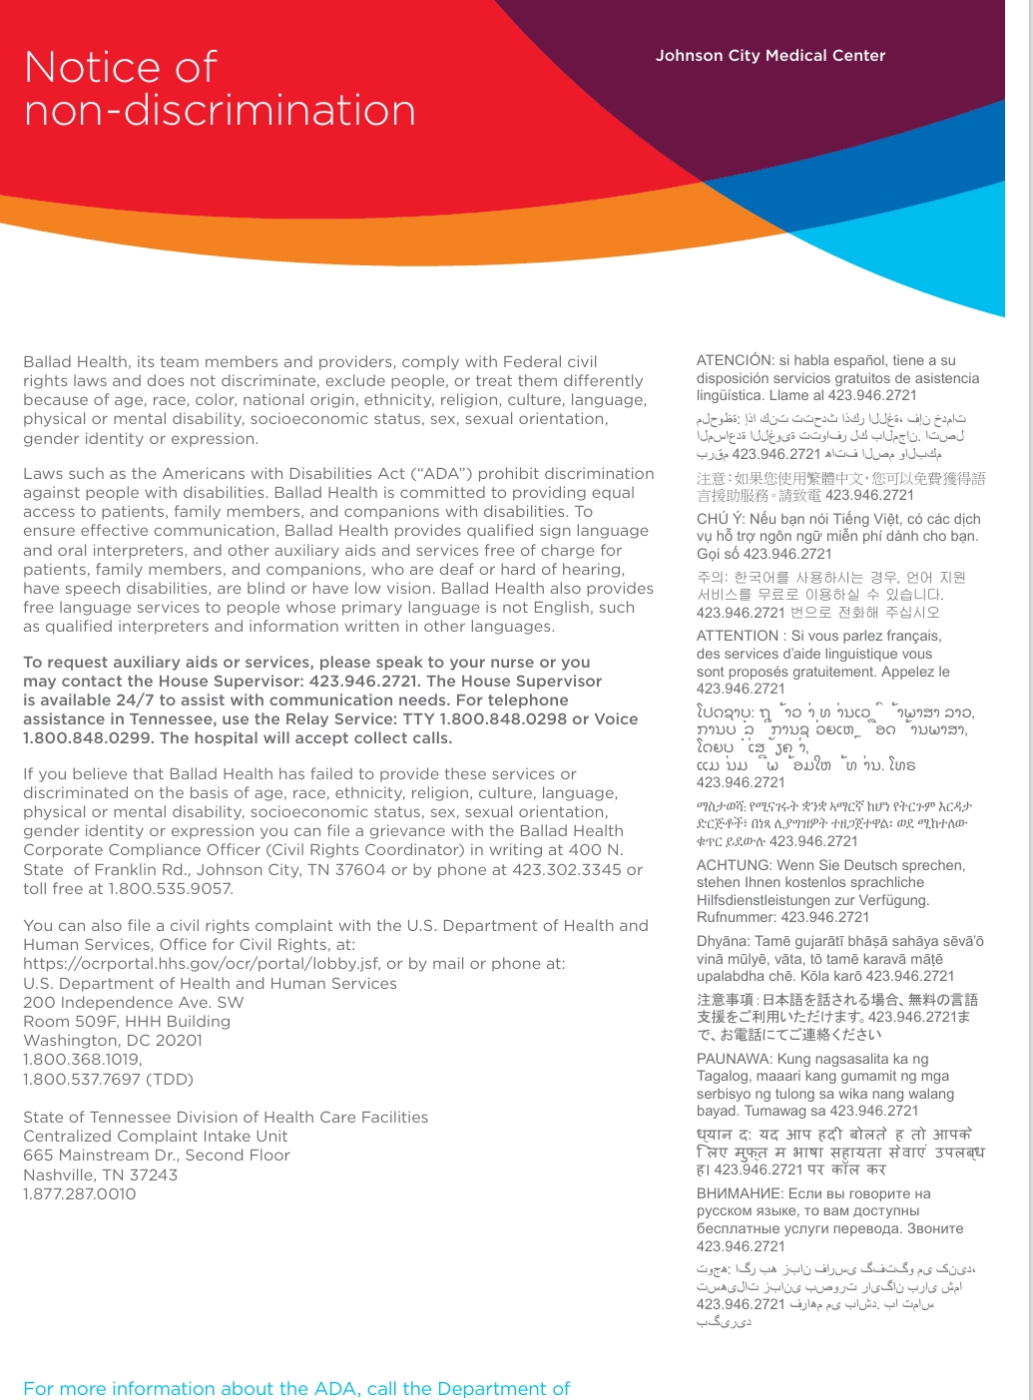
Ballad Health’s Non-Discrimination Claus
Ballad Health as an organization states it will not discriminate based on age, race, religion, language, etc.
Ballad Health will not discriminate against people with disabilities

Slide 5

Language and Interpreter Services
Ballad Health offers other services such as:
  Remote video interpreters (VRI)
  On-site interpreters in Spanish and sign language
  Over-the-phone translators in 200+ languages
  Written translations in Spanish
  Auxiliary aids such as:
    Phone amplifiers
    Video phones
    Illuminated magnifiers
    Oral readers
    Closed captioning

Slide 6

Religious Services
Ballad Health offers 24/7 chaplain services
They also have representatives for most major world religions

Slide 7
Pros and Cons
Ballad Health has several services for Spanish-speaking people
There seem to be adequate services for religious needs
There are not many services for people that speak languages other than Spanish
There are not services for the blind, such as Braille
There are no documents in any languages other than English and Spanish

Slide 8
References
8
Center for Spiritual Health Services. Center for Spiritual Health Services. Ballad Health. (n.d.). https://www.balladhealth.org/resources/spiritual-health- services
Communication Assistance & Interpreter Services. Communication Assistance & Interpreter Services. Ballad Health. (n.d.). https://www.balladhealth.org/patients-visitors/communication- assistance
Minority Health. (n.d.). Clas standards. Think Cultural Health. https://thinkculturalhealth.hhs.gov/clas/standards
Notice of non-discrimination. Notice of Non-Discrimination. Ballad Health. (n.d.). https://www.balladhealth.org/notice-non- discrimination

